Slide 1
Cloud Platform Modernisation
June.9.2023

Slide 2
Business Understanding (ABC Corp. Platform Modernisation)
All the Corp’s data were on prem and was not accessible globally. We are entrusted with the job of shifting all the on prem data on cloud. Also , we are expected to deliver a system so that the corporation’s data can be used by corporation for further analysis and get more targeted customers . Furthermore , HR dataset, Clickstream and Social Media Data would be analysed to enhance the business operation , strategize the marketing needs and give an overview of employee performance.

Slide 3
High Level Solution with services explained
Following services were used to deliver the desired project for ABC corp: S3: is used to store and retrieve data in the cloud, providing scalable object storage for the on-premises data and other relevant datasets.
Kinesis: enables real-time streaming and processing of data from various sources, such as clickstream and social media data, for analysis and business operation enhancements.
SageMaker: is utilized for building, training, and deploying machine learning models, allowing the corporation to leverage AI capabilities for data analysis and targeted customer insights.
Lambda: provides serverless computing capabilities, allowing the corporation to run code without provisioning or managing servers, which can be used for various tasks like data processing or triggering actions based on events. Athena: is a serverless query service that enables querying data stored in S3 using standard SQL, facilitating ad-hoc analysis of the stored data for business needs. continued..

Slide 4
High Level Solution with services explained
OpenSearch Dashboard: is a visualization tool that allows the corporation to create interactive dashboards and visualize the analysed data for business intelligence and monitoring purposes. Glue: Glue is an extract, transform, load (ETL) service that automates the process of preparing and transforming data for analysis, enabling efficient data integration and consolidation from different sources.
IAM: is used to manage user access and permissions to AWS resources, ensuring secure access to the corporation's cloud-based data and services.
Cloudwatch: provides monitoring and observability capabilities, allowing the corporation to monitor the performance, logs, and metrics of the cloud-based data system and related resources.
AWS pricing calculator: is a tool that helps estimate the costs associated with utilizing various AWS services, enabling the corporation to plan and budget for the cloud migration and ongoing usage.

Slide 5
Various success criteria for this program
Initial Module:
Data Migration System Availability Data Quality Performance and Scalability Security and Compliance Stakeholder Satisfaction Ongoing Program Data Analysis and Insights Targeted Customer Acquisition Business Enhancement Data Governance Return on Investment (ROI)

Slide 6
Processes & protocols that enable communication while balancing outside hours stretch
Define communication expectations : Being crisp and clear about agenda of Meet Prioritize and categorize communication : Prioritize the work load
Use asynchronous communication channels : use application like mail or teams Foster a culture of flexibility and understanding : Understanding Team Availability outside working hours

Slide 7
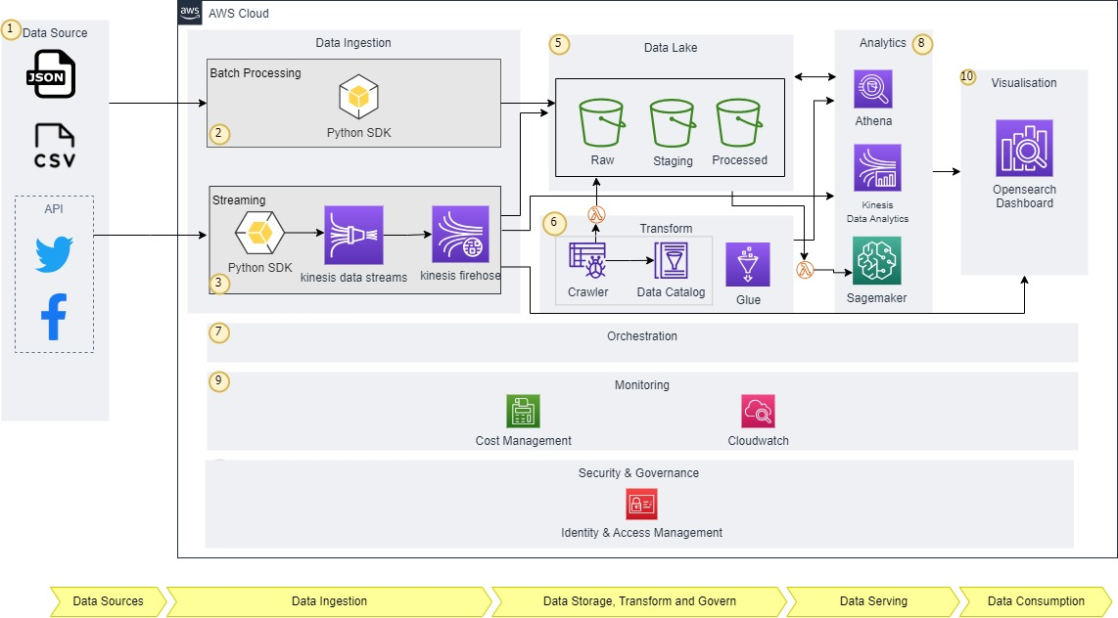
Proposed Architecture
The following architecture was proposed keeping in mind business needs , company requirement and cost management.
Requirement gathering
Input data
1. JSON
2. CSV
3. API
Data ingestion
1. batch
2. stream
Data staging
ETL
Data analytics & visualisation
Insert graphic here

Slide 8
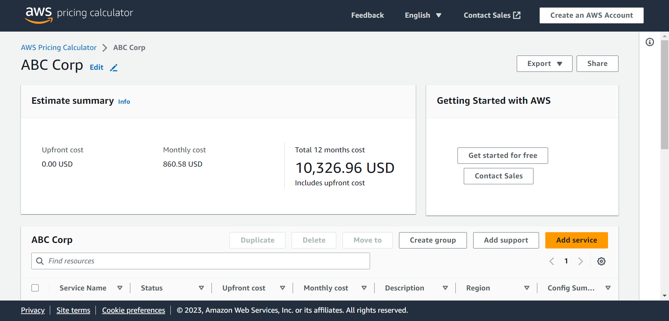
Cost Estimation

Slide 9
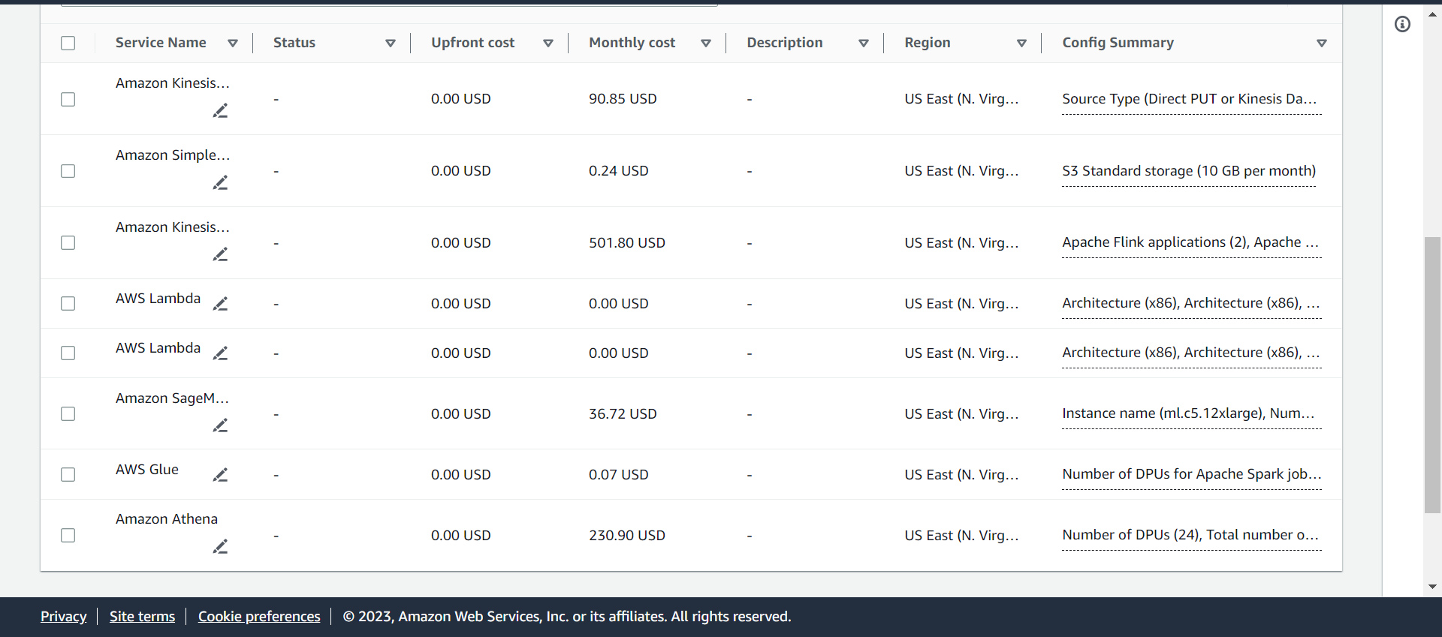
Services Used and Estimation /Upfront Cost

Slide 10
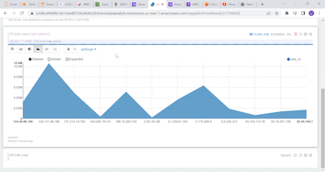
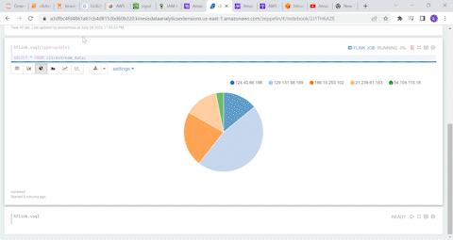
Kinesis Real Time Analytics
Note: these are GIFs, you can notice the live changing graphs
Live user activity over time i.e.
populating ip address Further more inference are followed in next slide.

Slide 11
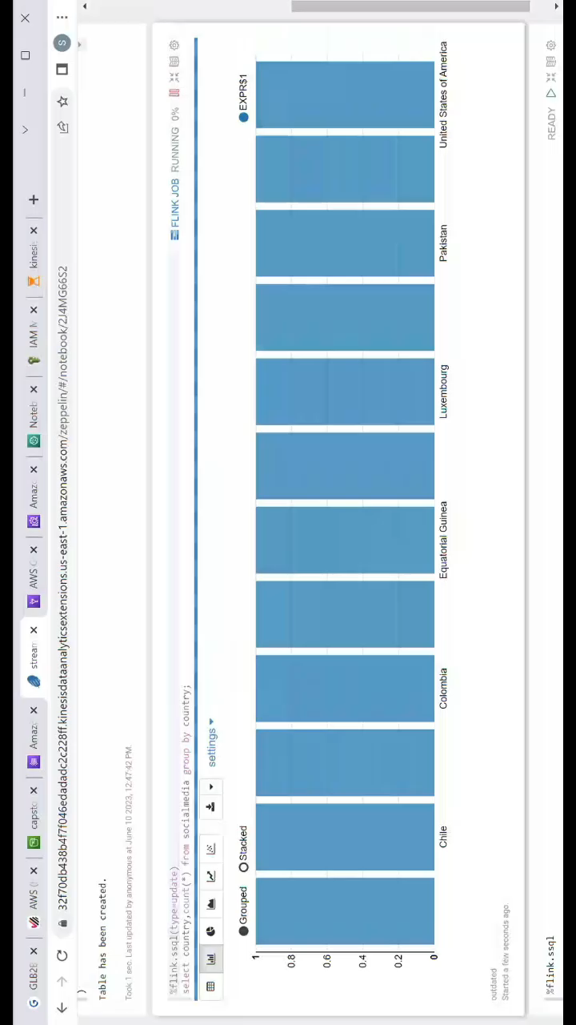
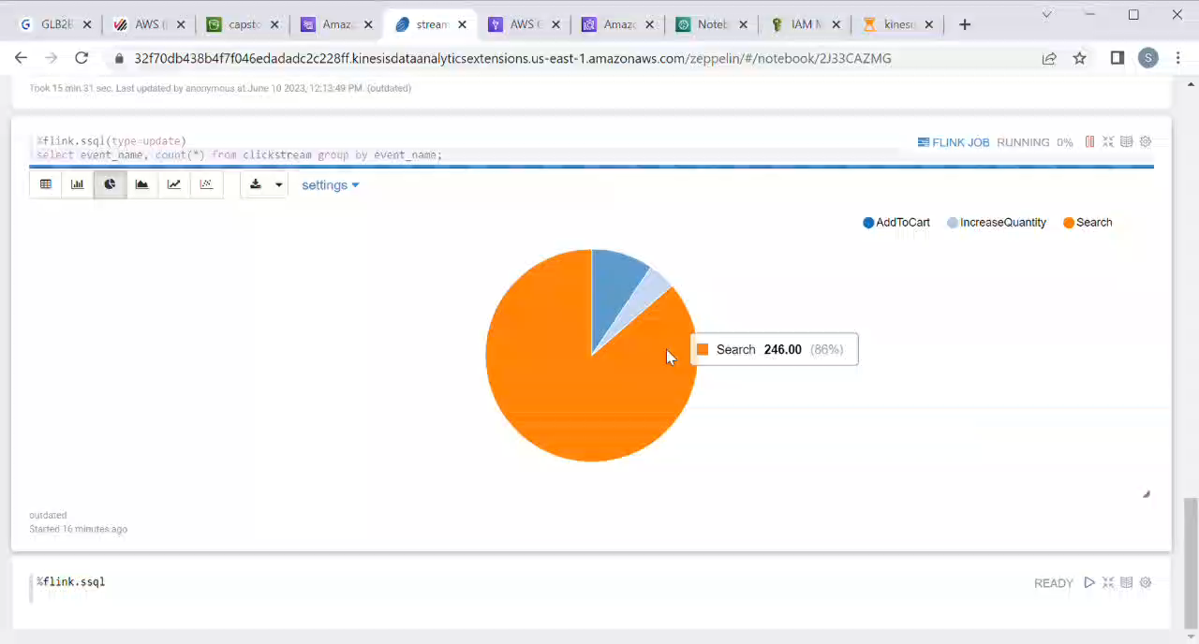
Kinesis Real Time Analytics
Note: these are videos, make sure to play them to see the live changing graphs.
Country wise traffic over time. Observation : We can see that the following countries have active users on ABC corps' website.
Events performed by user on website Observation : We can see that most of the users are looking for tools, while some where adding to cart and some of them were increasing the quantity of items added in cart.

Slide 12
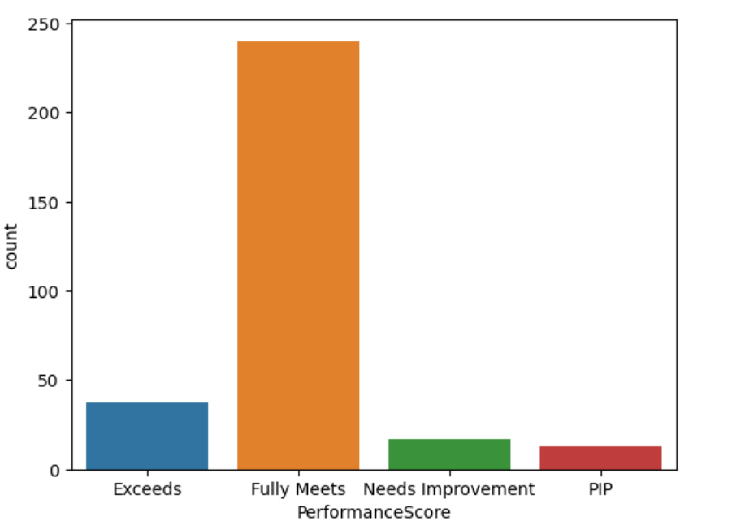
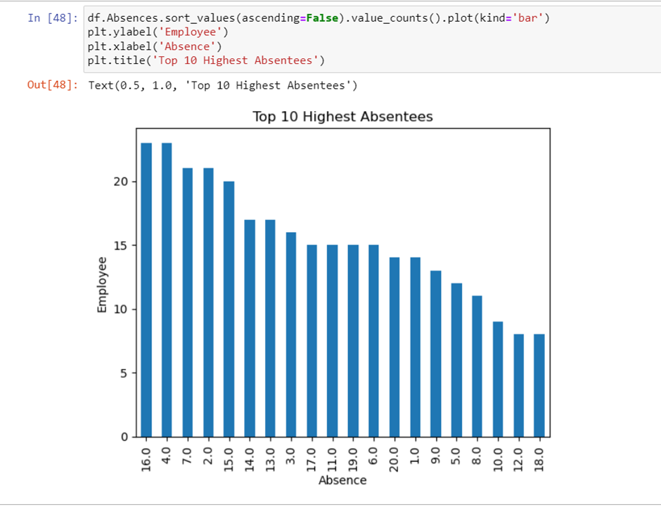
HR Dataset Analytics
Employee Performance Observation : The following columns were analysed on the basis of columns given by ABC corps’
Top 10 Absentees Observation : The following graph shows the number of employees taking leave monthly

Slide 13
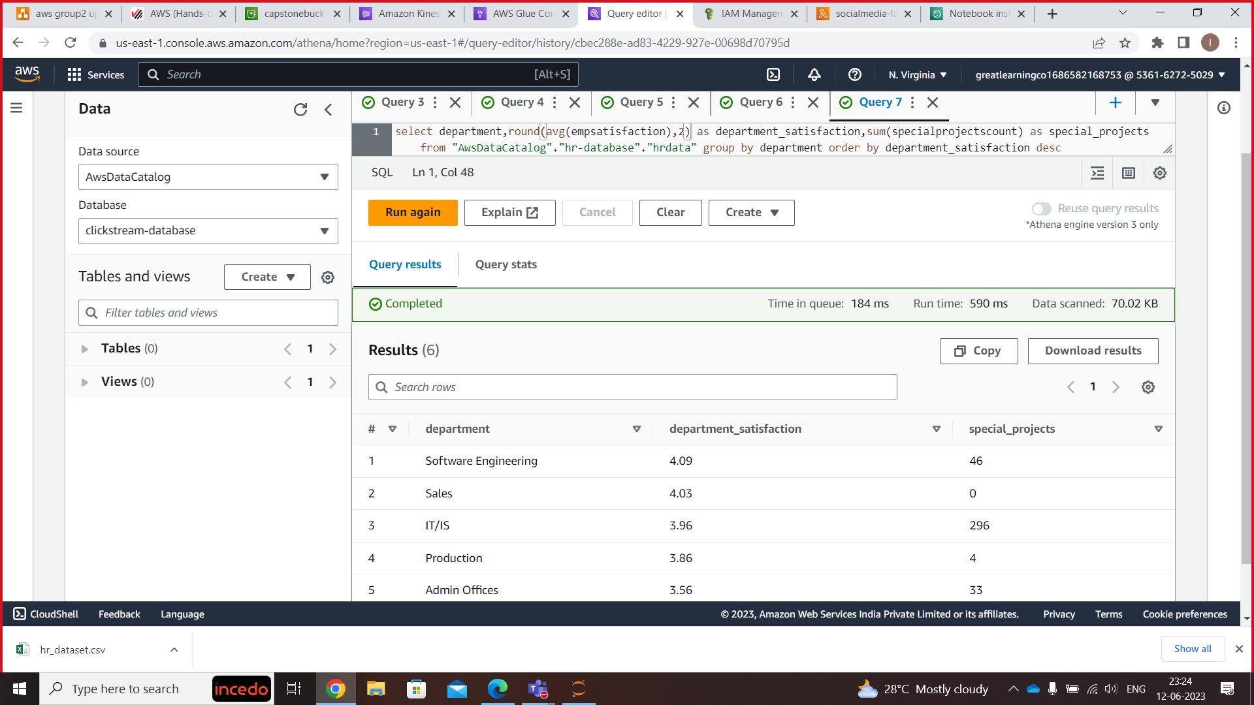
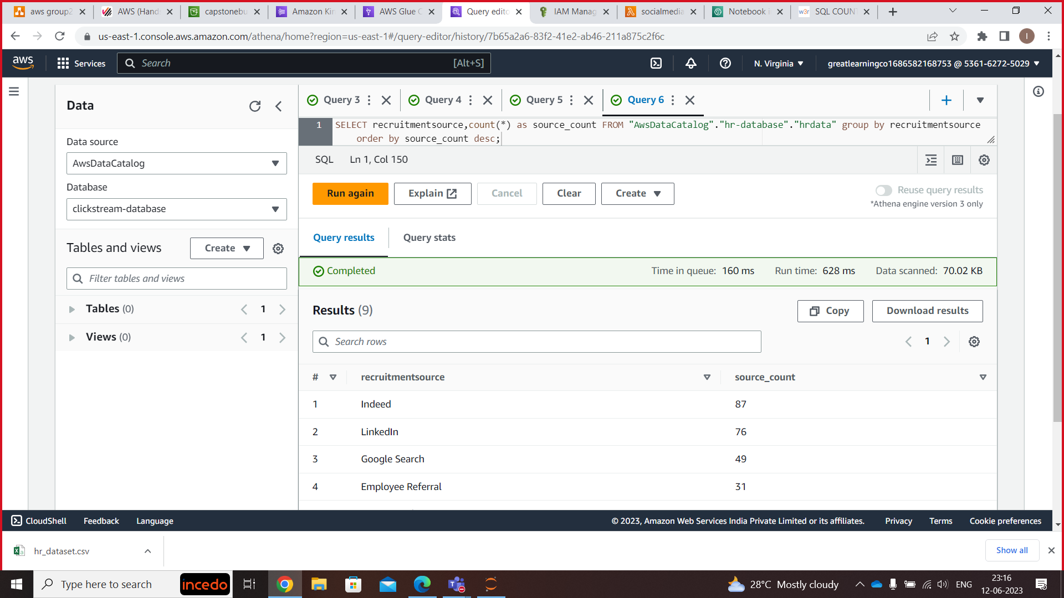
HR Dataset Analytics
Department wise average employee satisfaction Observation : The employees of software engineering were found to be most satisfied with their work followed by sales and IT/IS.
Recruitment Sources Observation : The following data shows that Indeed gave the highest number of candidates followed by LinkedIn.

Slide 14
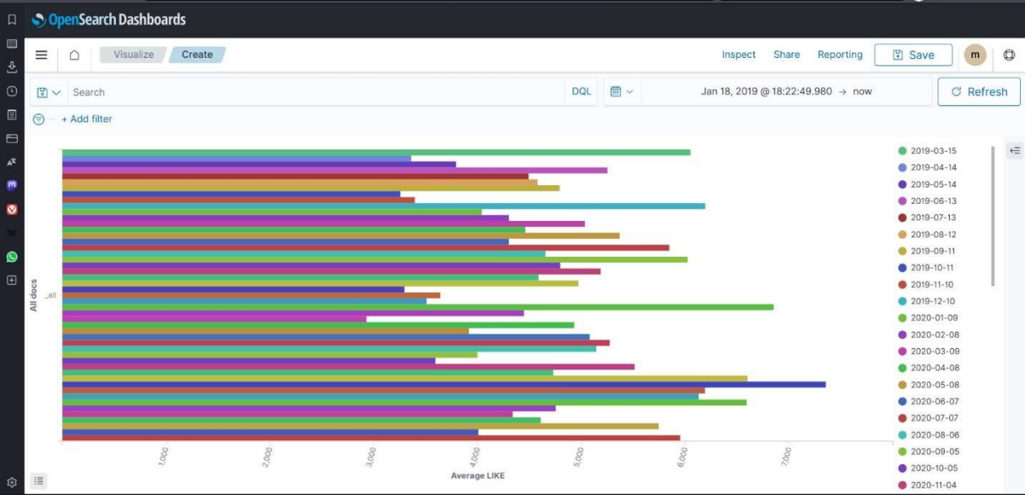
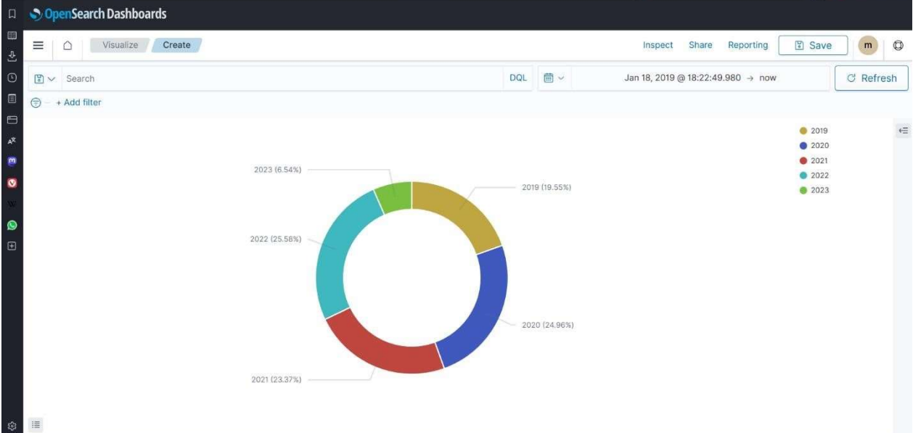
Open Search Dashboard
Likes over a period of time Observation : The following data shows how the user engagement is with the number of likes on monthly basis.
Number of likes over the years Observation : The following data the sum of likes as percentage distribution over the years.

Slide 15
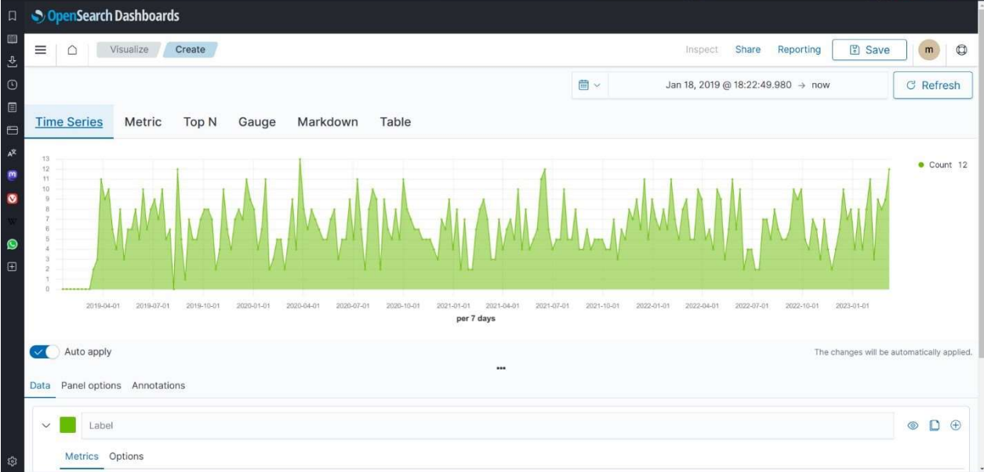
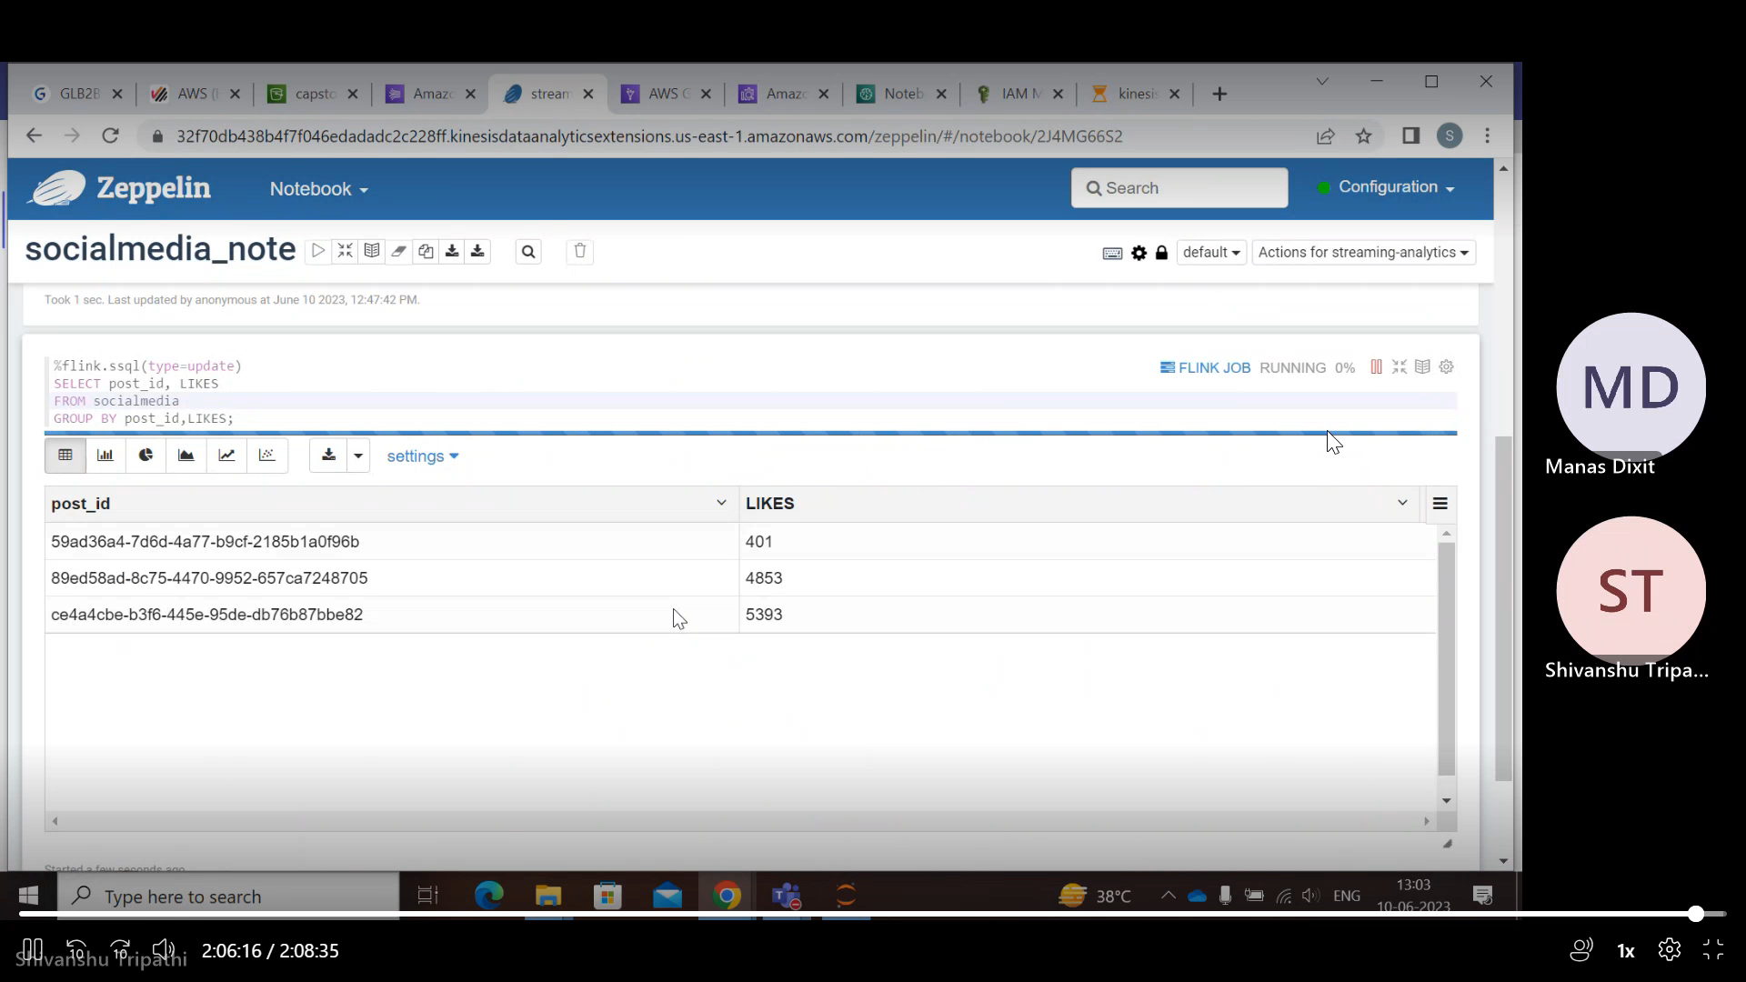
OpenSearch Dashboard
Note : This is live video.
Number of likes over the years Observation : The following data the sum of likes as percentage distribution over the years.
Number of likes over the years live stream Observation : The following data the sum of likes as percentage distribution over the years live .

Slide 16
Main Idea with Timeline and Key Pointers
20 May
23 May
29 May
8 June
11 June
Key Pointer 1
Problem Statement Release
First Group Meet Possible Architecture
Pipeline Working Tested on Static Data
Final Pipeline tested on live clickstream data .
Final Project Deployment with Live data ingestion and EDA
Mid Pointer
On 22nd June a meet with Uma was also connected that gave an idea about kind of architecture to move forward with.
Timelines were strictly followed with regular team meets and constant feedbacks to meet estimated cost and deployement.
Key Pointer 3

Slide 17
Thank You
www.incedoinc.com

